Slide 1

Functional and Non-Functional Requirements

Slide 2

What are Functional Requirements?
Functional Requirements are items or components that are required to make something work (function) correctly to a pre-determine specification.

Slide 3
What are Non - Functional Requirements?
Non-Functional Requirements are items or components that don’t have an impact on how something performs or functions.

Slide 4
What is a Functional Requirement of a Car?

Slide 5
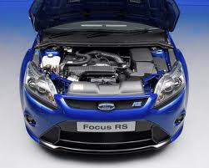

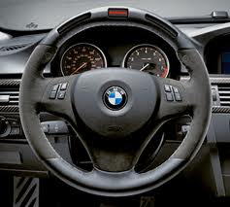
What is a Functional Requirement of a Car?
A car needs to take you from A to B . To do this it has to accelerate, Slow down and turn corners. To do this it Requires: Engine , Wheels, Steering Wheel, Gearbox, Accelerator, Brake and Petrol.

Slide 6
What is a Non-Functional Requirement of a Car?

Slide 7
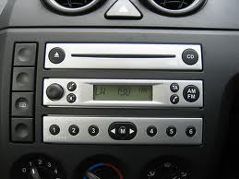
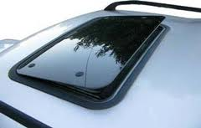

Non-Functional Requirements of a Car
Car radio, Sunroof, electric windows and Colour choice.
A car can still function correctly without any of the above.

Slide 8


Slide 9
What is Pseudocode ?

Slide 10
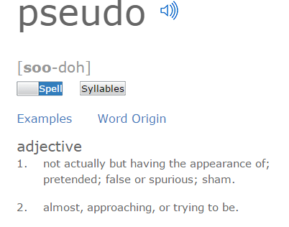
Pseudo – Dictionary Meaning

Slide 11
What is Pseudocode ?
As we know most programs are developed using programming/scripting languages
These languages have specific syntax that must be used so that the program will run properly
Pseudocode is not a programming language, but instead a very simple way of describing (in plain English or any other language) a set of instructions that will eventually be turned into real code and executed

Slide 12
Common programming terms found in Pseudocode Examples
Input – indicates user interaction (clicking a button or typing in a text box)
Output – indicates feedback (message box/dialog window or a sound/ beep)
If – Then – Else – a decision (selection) in which a choice is made
For – loops through a block of code a number of times (iteration)
While – a loop (iteration) which loops through a block of code while a specified condition is true

Slide 13
Pseudocode Example for Speed Limit in pedestrian area
If car speed is greater than 30 mph Then
  Display sad face
  Display car speed
Else
  Display happy face
  Display car speed
End If

